Slide 1
Keeping Labor Safe – Phase 2
Machine Learning Outcomes
Lucas Finco

Slide 2
Analysis Process (to date)
Update trace plotting to include mark-ups
Collection of Ground Truth
193 traces as of 1/6/2020
Evaluation methods of algorithm established
Tuning of algorithm parameters

Slide 3
UA Contraction Parameter Tuning
Two Parameters to tune
Minimum time duration to be called a contraction
Minimum rise in UA for UC threshold
Alternate UC threshold using % of Max-Min UA
Three graphs provided:
False Positive Rate vs. False Negative Rate
Mean Square Error and Mean Absolute Error (of number of contractions)
Precision vs. Recall

Slide 4
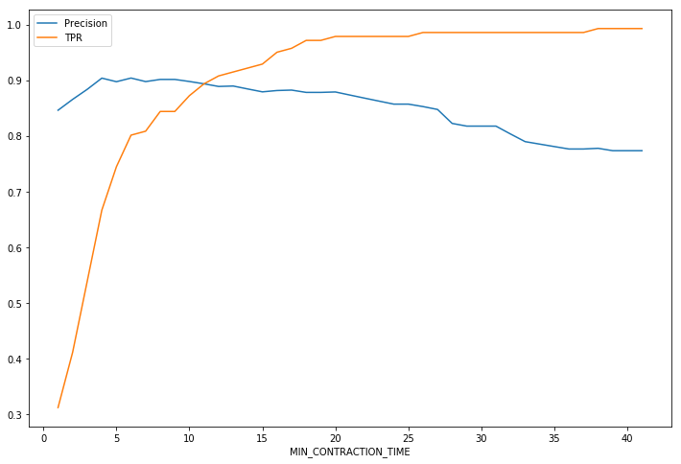
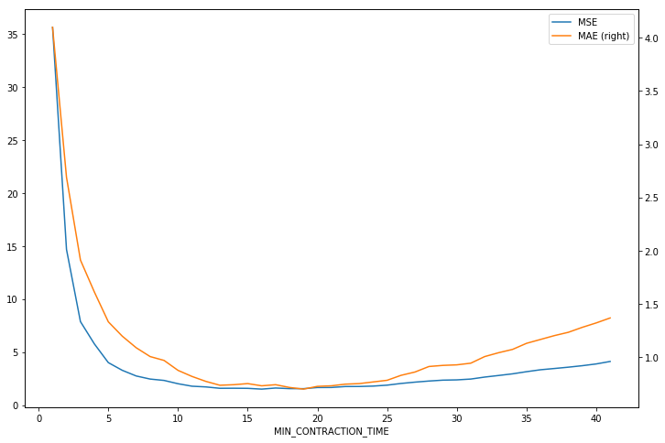
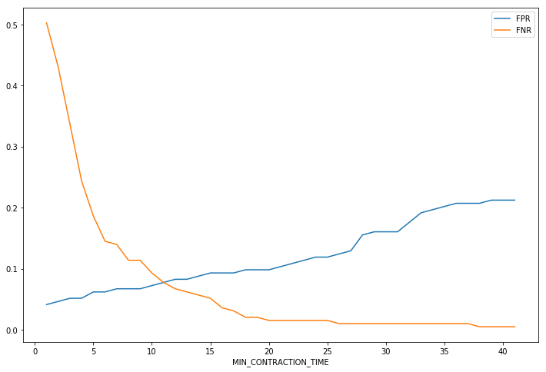
UA Contraction Parameter – Minimum Duration
Recommended Value: 14s
Notes:
44min 55sec to run 41 cases

Slide 5
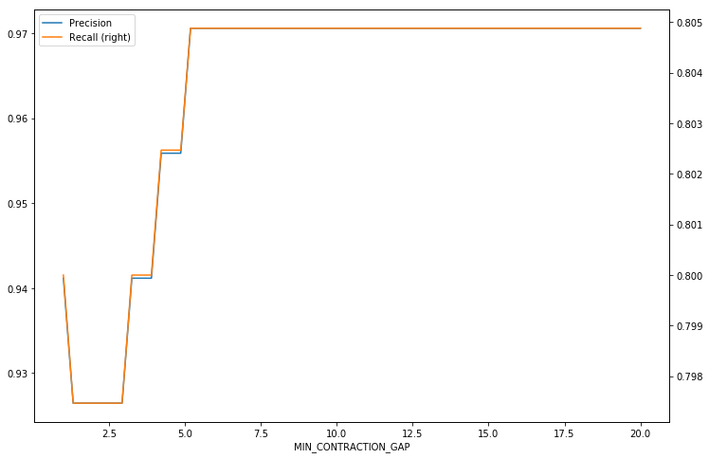
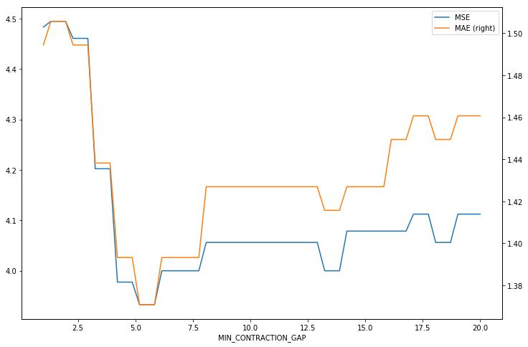
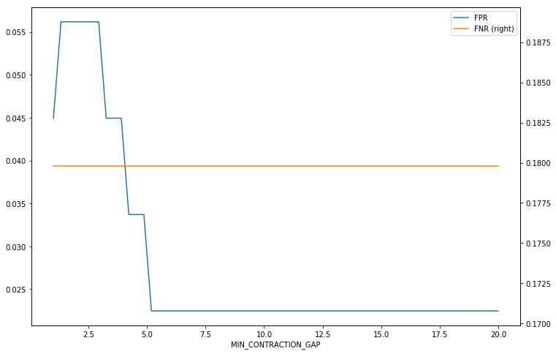
UA Contraction Parameter – Minimum UA Gap
Recommended Value: 5.5

Slide 6
UA FRI Component
Three ways to calculate FRI component
More than 5 UC’s
U/R Ratio > 4
More than x crossings of min-max value

Slide 7
FHR Parameter Tuning
Parameter to tune
Threshold for acceleration/deceleration
Three graphs provided:
False Positive Rate vs. False Negative Rate
Mean Square Error and Mean Absolute Error (count of accels)
Precision vs. Recall

Slide 8
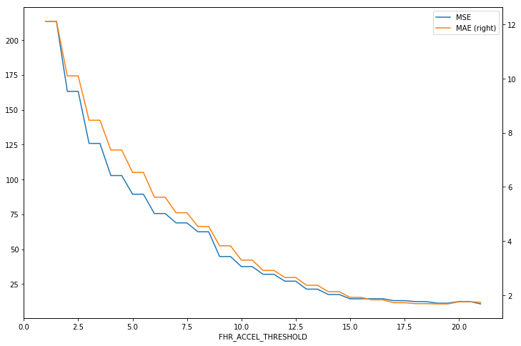
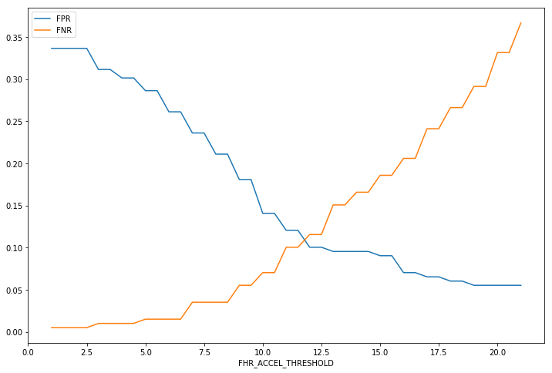
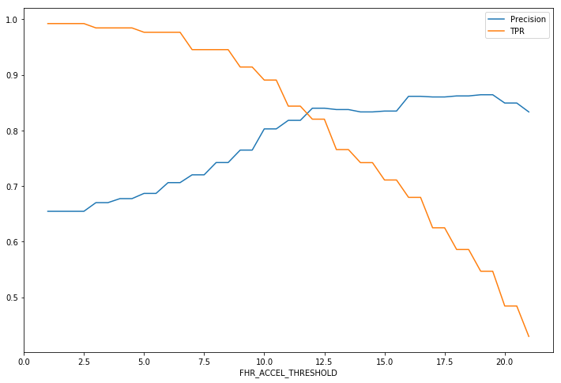
FHR Acceleration – FHR Acceleration Gap
Recommended Value: 10

Slide 9
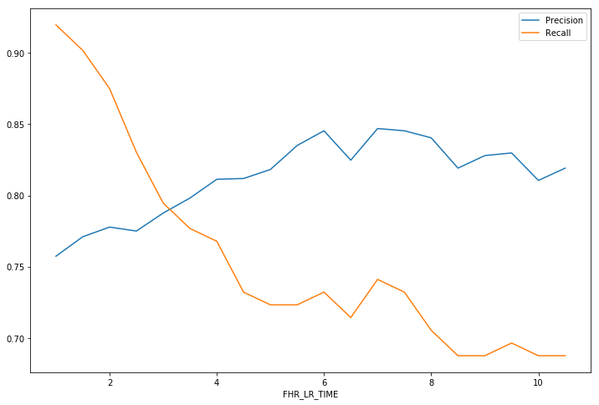
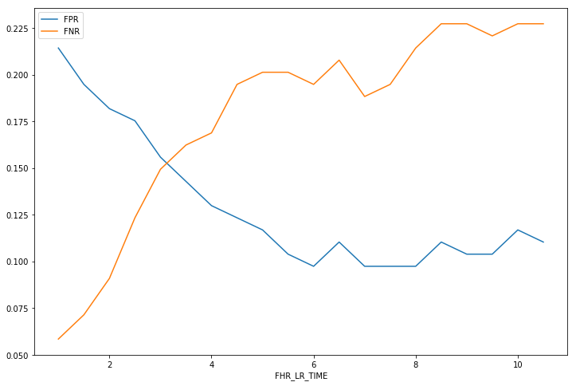
FHR Late Recovery – Seconds after Contraction
Recommended Value: 3

Slide 10
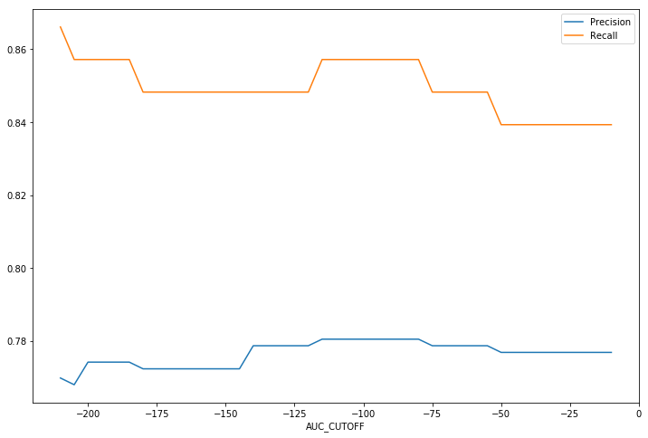
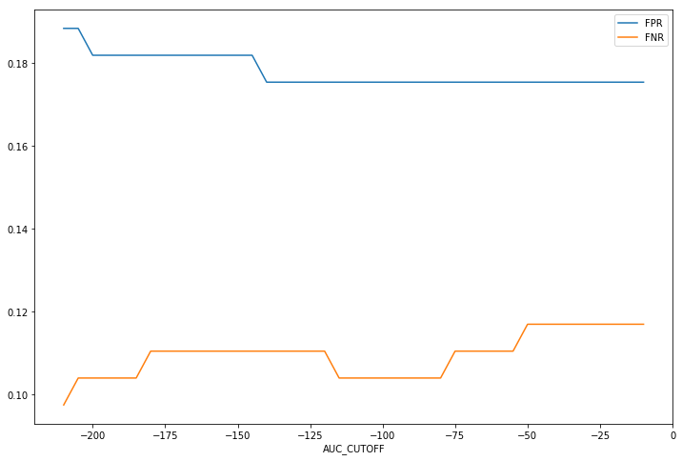
FHR Late Recovery – AUC after Contraction
Recommended Value: -100

Slide 11
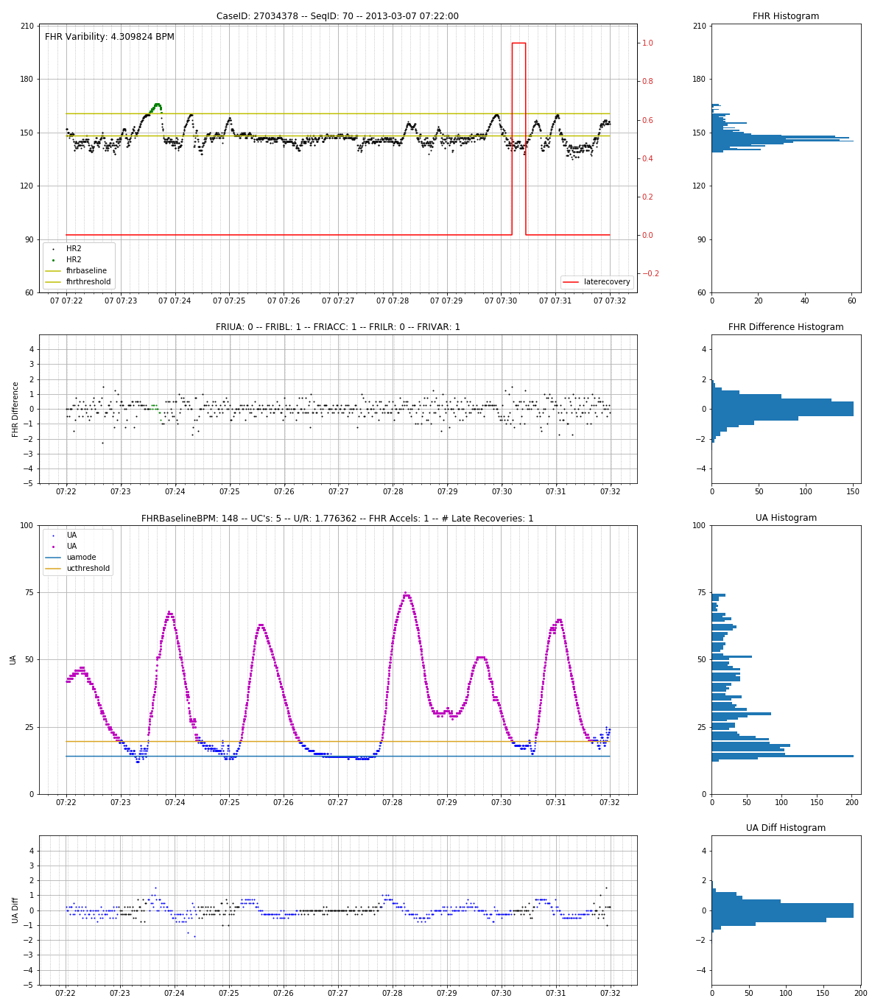
Advanced Plotting
Improved visualization with deltas and histograms

Slide 12
Results: Excessive UA
Number of contractions exceeds 4 in 10 minutes
Accuracy: 85%
Sensitivity, Recall: 91%
Specificity, TNR: 69%
Precision, PPV: 89%
NPV: 75%
Excellent result, room for improvement
 | Predicted
Actual |  | 0 | 1
 | 0 | 36 | 16
 | 1 | 12 | 129

Slide 13
Results: FHR Accelerations
FHR Accelerations = 0
Accuracy: 65%
Sensitivity, Recall: 82%
Specificity, TNR: 50%
Precision, PPV: 59%
NPV: 76%
Accel Count MAE: 1.49
Needs Improvement
 | Predicted
Actual |  | 0 | 1
 | 0 | 41 | 41
 | 1 | 13 | 59

Slide 14
Results: FHR Baseline
FHR Baseline < 110 or >= 160
Accuracy: 95%
Sensitivity, Recall: 95%
Specificity, TNR: 66%
Precision, PPV: 99%
NPV: 22%
Very strong result, note only one zero, no improvement needed
 | Predicted
Actual |  | 0 | 1
 | 0 | 2 | 1
 | 1 | 9 | 142

Slide 15
Results: FHR Variability
FHR Variability < 5 or > 15
Accuracy: 81%
Sensitivity, Recall: 98%
Specificity: 21%
Precision, PPV: 81%
NPV: 78%
Good result, better at predicting zeros, which is important, but missed 5 zeros
 | Predicted
Actual |  | 0 | 1
 | 0 | 16 | 18
 | 1 | 8 | 112

Slide 16
Results: FHR Late Recovery
FHR Late Recovery Present
Accuracy: 77%
Sensitivity, Recall: 88%
Specificity: 50%
Precision, PPV: 82%
NPV: 60%
True Negative Rate: 50%
Good result, confident in prediction, but weak with actual zeros, and 2 false negatives
 | Predicted
Actual |  | 0 | 1
 | 0 | 17 | 25
 | 1 | 30 | 82

Slide 17
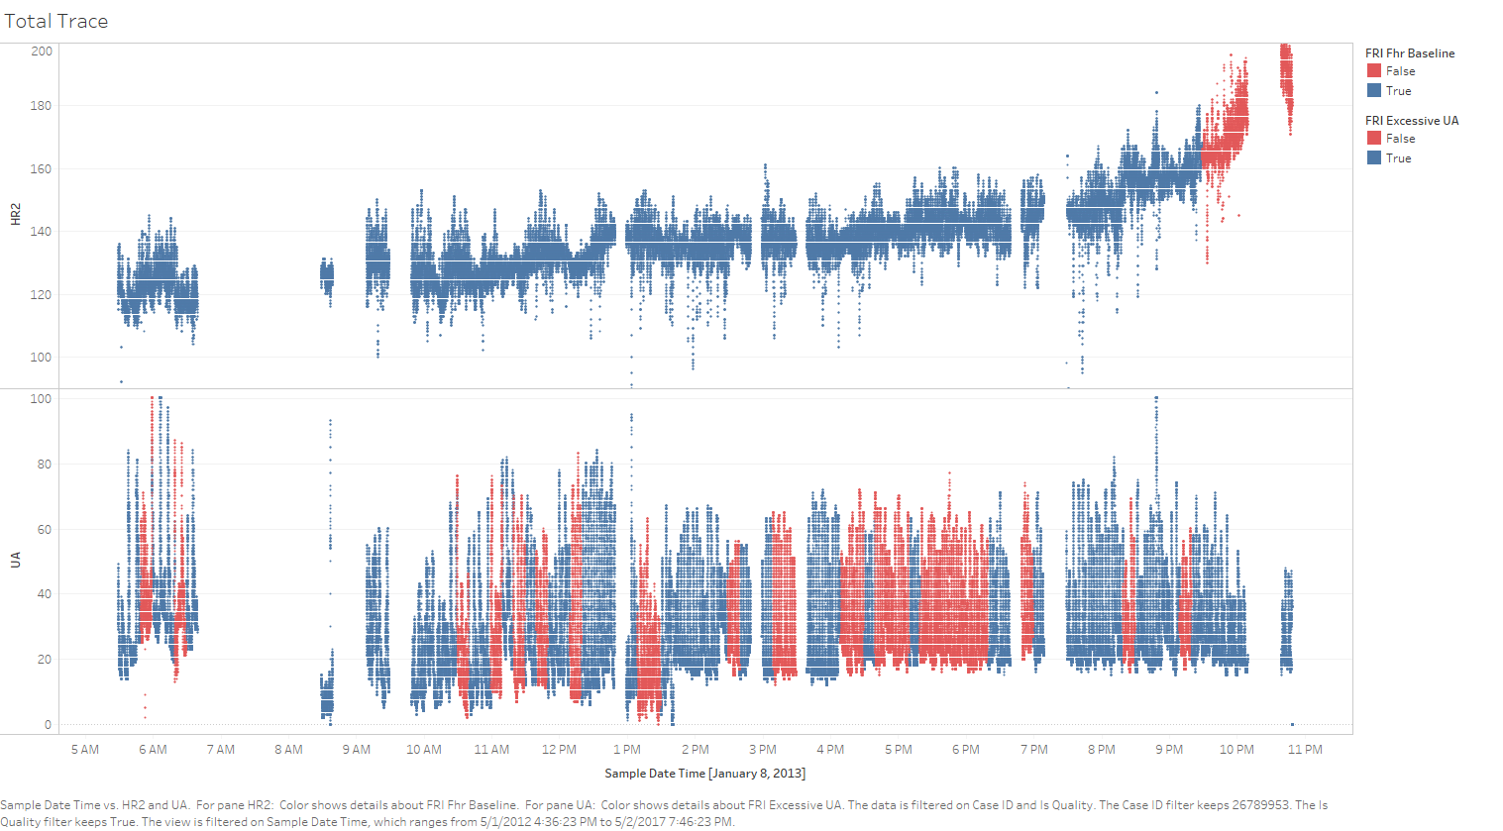
Case Study: CaseID 26789953
Notes:
Note FHR baseline tachycardia properly identified

Slide 18
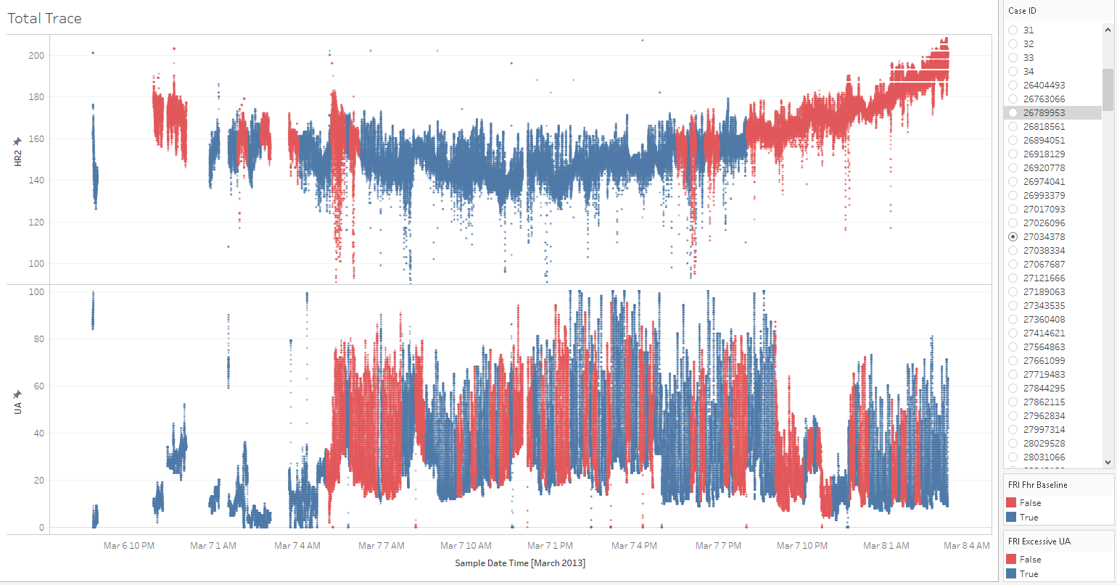
Case Study: CaseID 27034378
Notes:
Note FHR baseline properly identified

Slide 19
ToDo’s:
Use AUC method for late recoveries
Analysis Confidence Metric

Slide 20
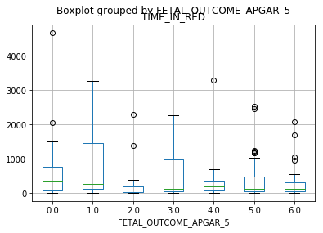
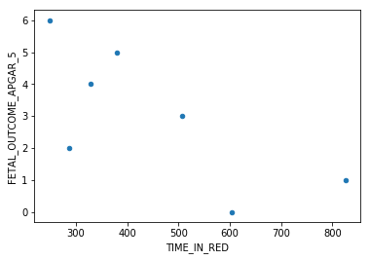
FRI Correlations to Outcomes
Notes:
As of 1/7/2020

Slide 21
FRI Correlations to Outcomes

Slide 22
Recommendations
Collect ground truth at the source of the data
When contractions happen
When accelerations happen
When late recoveries happen

Slide 23
Appendix

